Slide 1


Meon
Glory awaits you.
Ana Rita Lamelas
João Fonseca

Slide 2
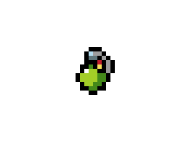
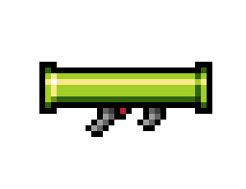
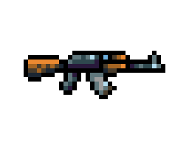


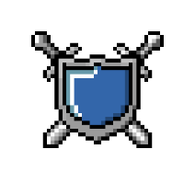
Meon - Features
Multiplayer game where you need to kill your opponent.
Several weapons at your disposal.
Very low ammunition on each weapon, grab all you can.
Power-ups such as more health, armor and increased damage.
Jump and move around to dodge your enemy.

Slide 3
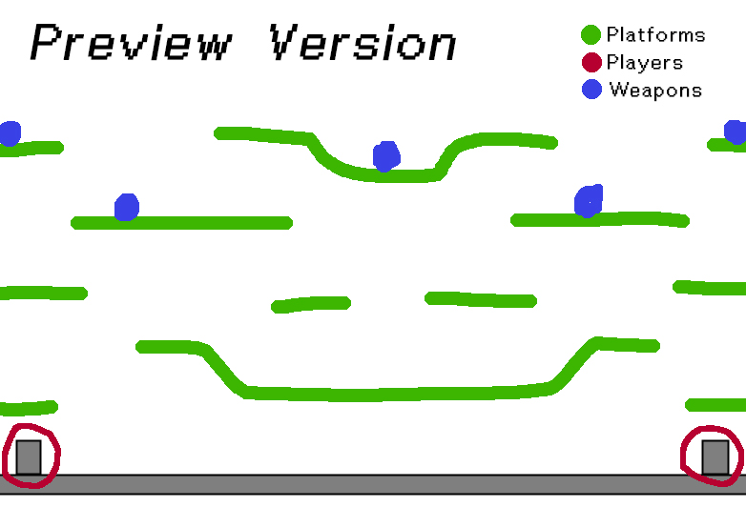
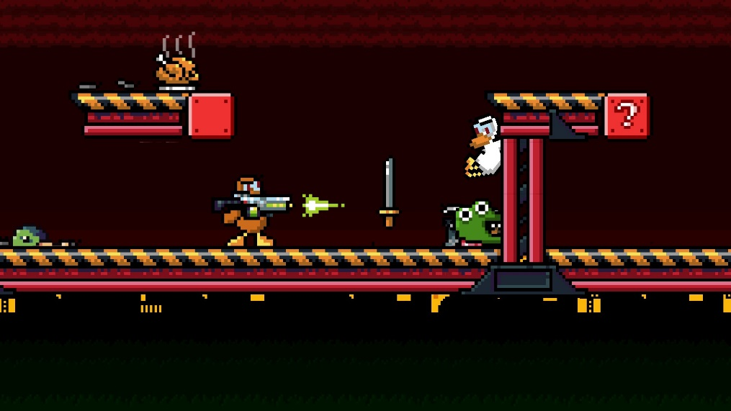
Meon - Features
1 vs 1;
Fast-paced and action-packed;
2D side view;
Pixelated art;
Controller support.
Duck Game by Landon Podbielski

Slide 4
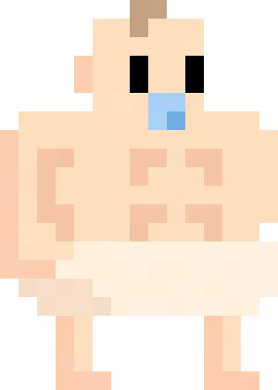
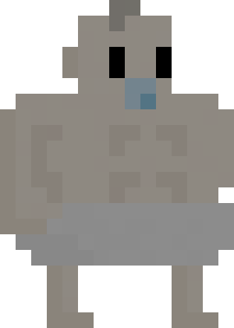

Meon – Playable Characters

Slide 5
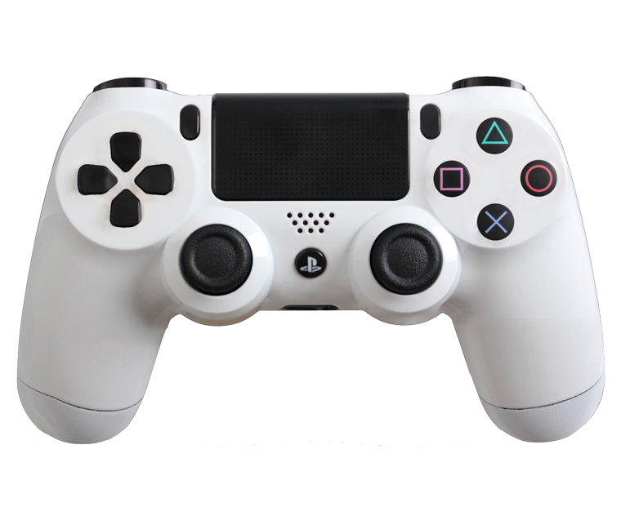
Meon - Controls
Use weapons;
Pick-up weapons;
Punch;
Jump;
Move.

